Slide 1
Endodontic Masters Competition 2025
Title
Presenter’s Name:
Email:
WhatsApp number:

Slide 2
CASE HISTORY/PRESENTATION
Give a brief and clear background of your case history in 1 or 2 slides
Intra oral picture of the case can be inserted

Slide 3
Diagnosis
Diagnosis of the case

Slide 4
Treatment sequence
The treatment sequence can be detailed in a few slides
Pictures of treatment sequence and radiograph should be included

Slide 5
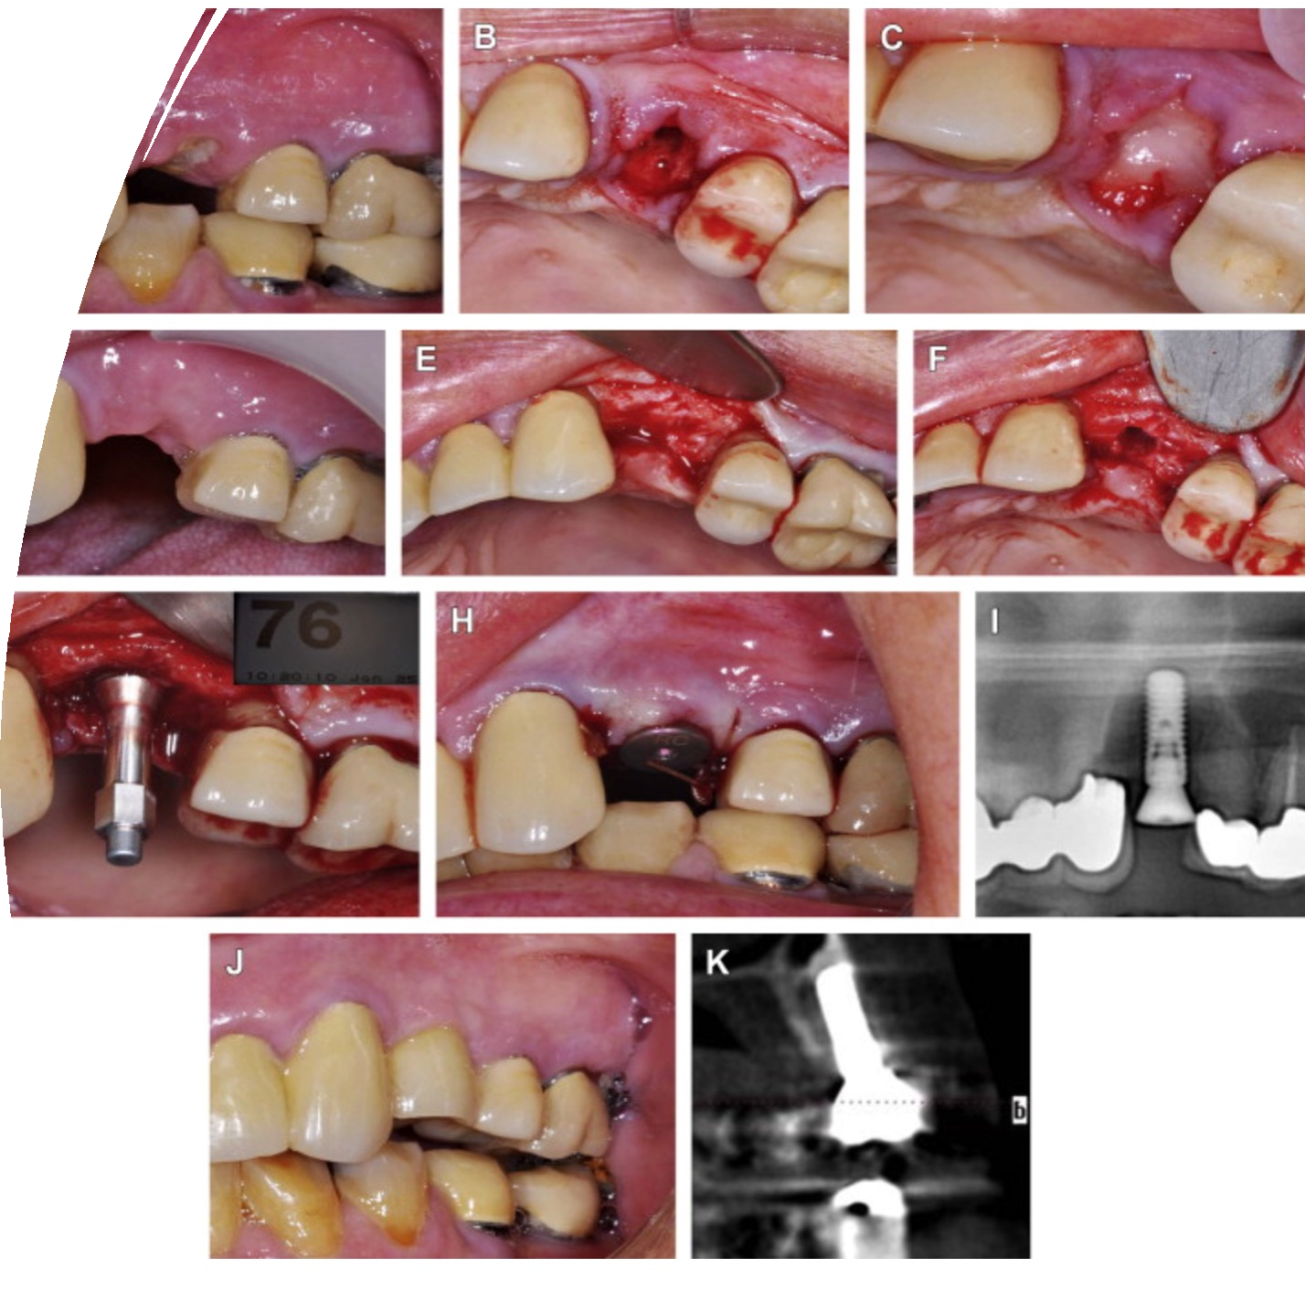
Picture collage of the treatment sequence

Slide 6
Clinical Suggestion

Slide 7
Short Case Summary
Short Case summary and supporting theory can be detailed in a few slides
600 words max

